Slide 1
Crime Rate vs Real Estate Prices
Baltimore, MD

Slide 2
Moving into a new city?
We have to find a home!
But what is the first thing it comes to mind before moving into a new home?

Slide 3
A SAFE NEIGHBORHOOD!

Slide 4
The data that we gathered…
We decided to go with Baltimore, Maryland since it was the city with the most crime data available.

Slide 5
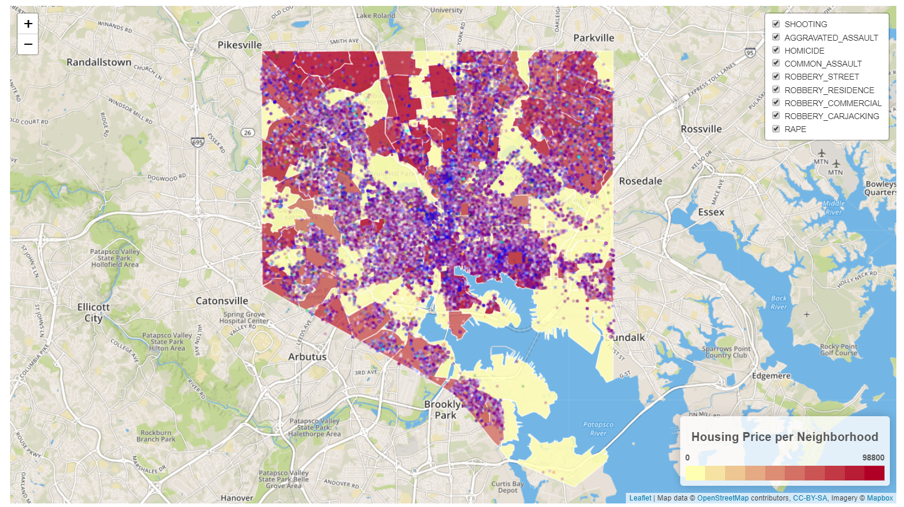
Leaflet Map
This map will show the crime visible by color through the nine categories for users to utilize

Slide 6
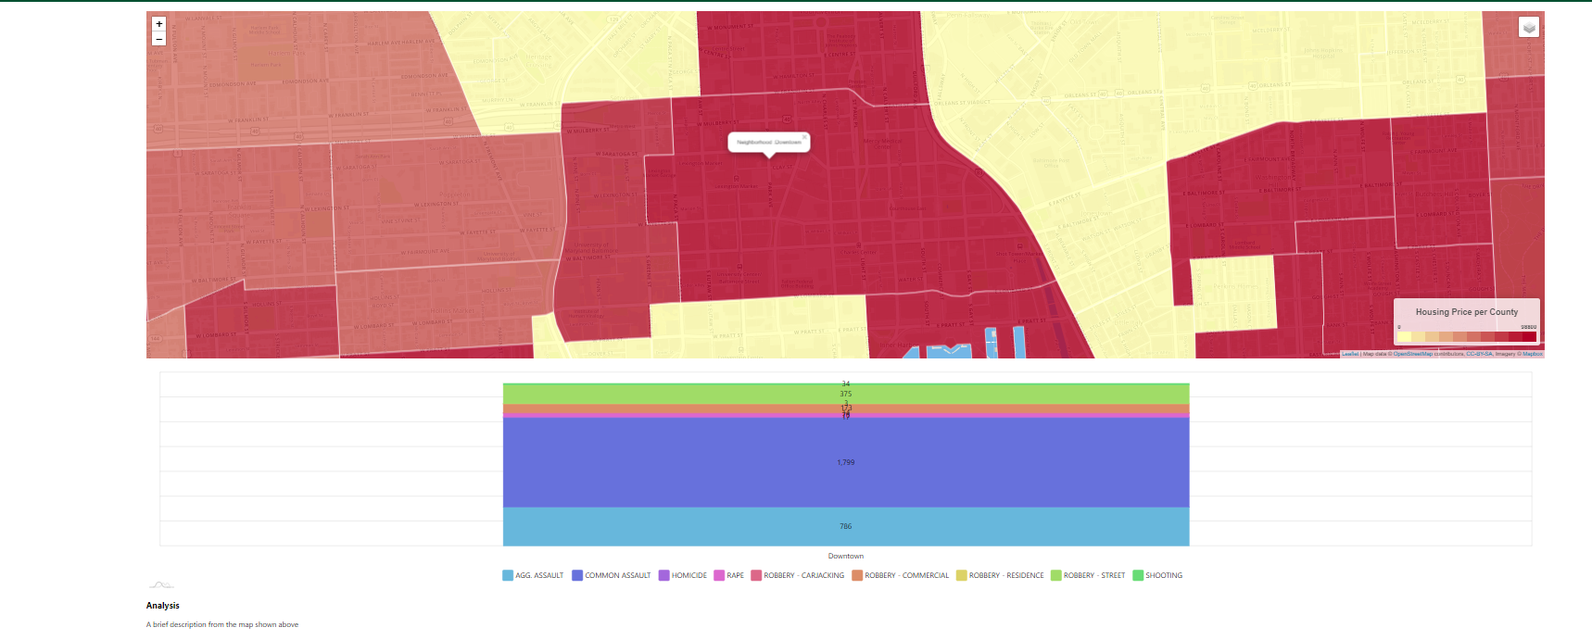
Main Landing Page
When selecting the region of the map, a stack chart pops up showing the type of crimes in the area. The most common one was Common Assault.

Slide 7
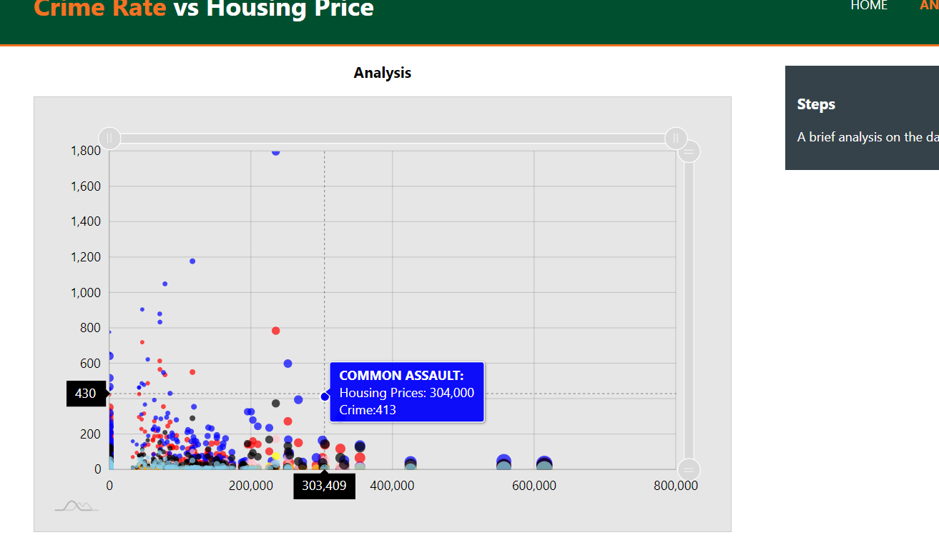
Analysis
As an analysis, we used scatter plots to show the correlation between the housing price and the crime type.

Slide 8
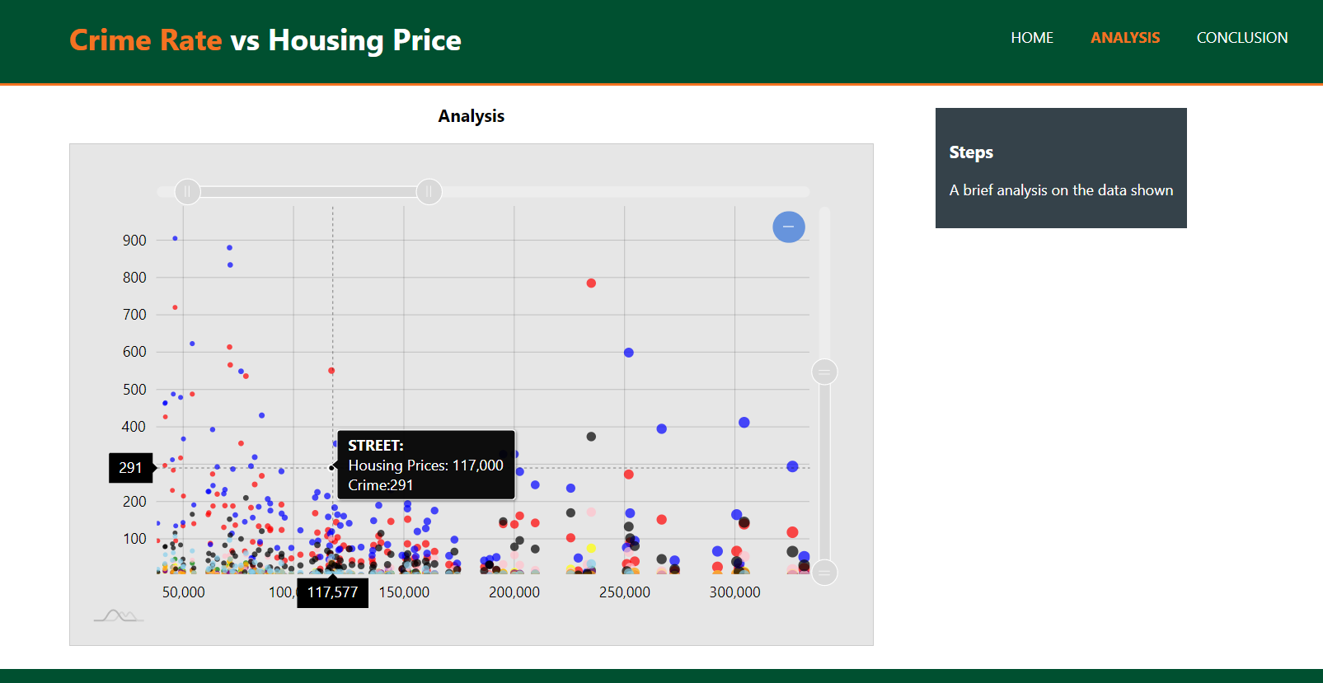
You can also zoom in to take a closer look of the data

Slide 9
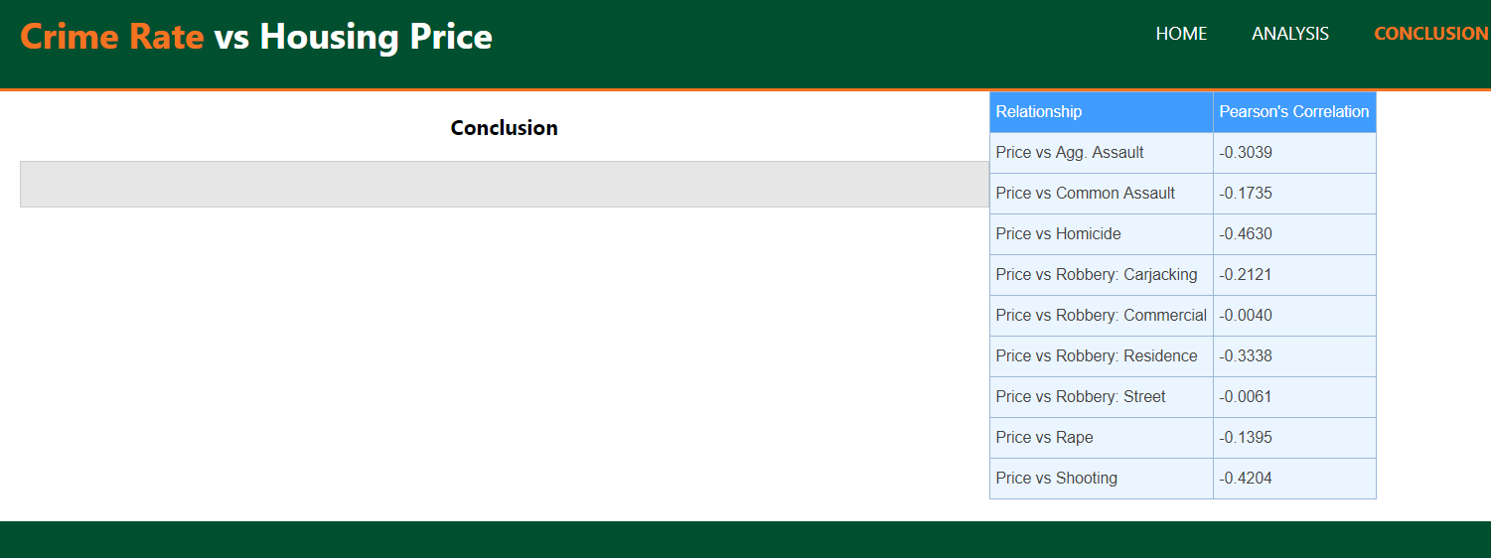
Table of correlations

Slide 10

The Developers

